Slide 1
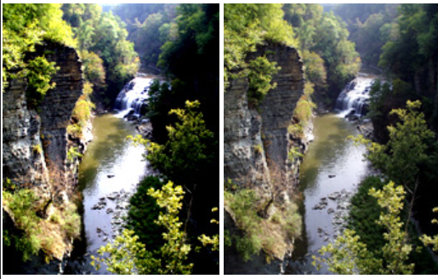
Dynamic range
Brightest to the darkest area of the image.

Slide 2
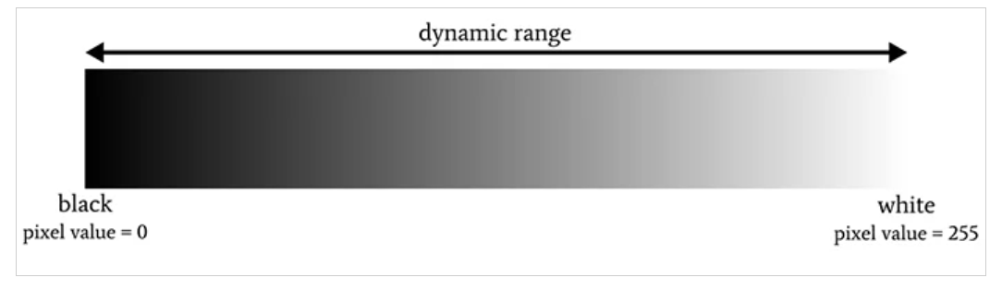
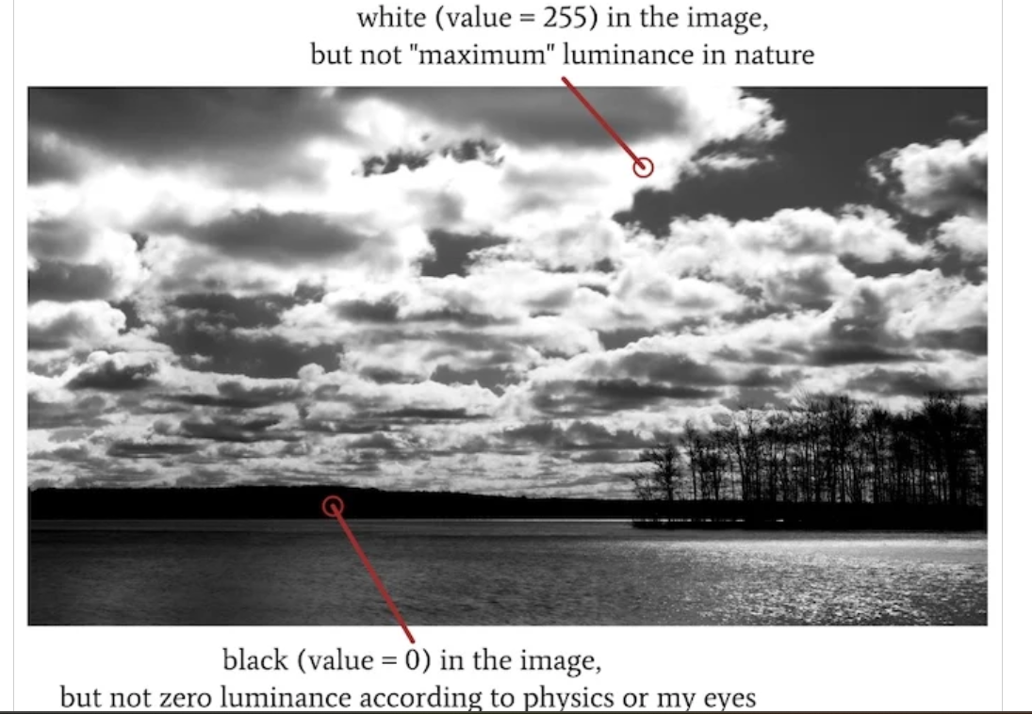

Slide 3
Dynamic range as the ratio between the luminance that produces white in the resulting image and the luminance that produces black in the resulting image. In a digital system, white corresponds to the highest possible ADC output value, and black corresponds to the lowest possible ADC output value. If we take the commonly used 8-bit grayscale range as an example, white = 255 and black = 0:
lets talk about visual perception.

Slide 4
High dynamic range
Multiple image
Each image in different exposure
The combination of information in this images gives HDR images
HDR images are more realistic and detailed.

Slide 5
Which one has high dynamic range? CCD or CMOS
CCD – HDR
max num of electrons in quantum well
CMOS – LDR
less num of electrons captured

Slide 6
Saturation
Saturation is defined by the purity of the color and its distance from the grey color. If a color has much more greyness, it has a lower saturation level. Moreover, saturation could be viewed as the hue's dominance in the color. The outermost edge of the hue wheel includes the pure hue; as you move inside the wheel to the centre, which contains grey, the hue steadily drops, and the saturation likewise falls. It relates to a physical property known as the excitation property, which measures the percentage of brightness mixed with the dominant or pure color.

Slide 7
